Slide 1
Koray Can Yurtseven
Section 47 Department of Computer Engineering

Slide 2

Two Reasons Behind Toyota’s Success

Slide 3
Overview
Company wise
Product wise

Slide 4
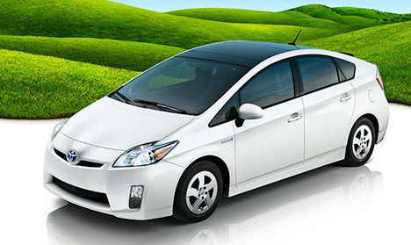
Company Wise
Obsession with waste
Humility
Long-term planning
Toyota Prius

Slide 5
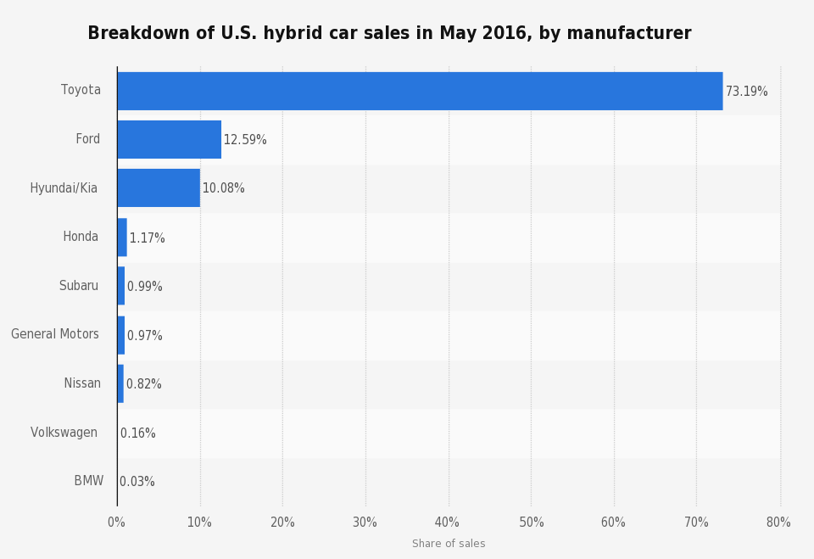
Company Wise
Retrieved from Statista.com

Slide 6
Product Wise
Durability
Top Safety Pick
Green Vehicles

Slide 8
Thank You

Slide 9
References
HybridCars.com. (n.d.). Breakdown of U.S. hybrid car sales in May 2016, by manufacturer. In Statista - The Statistics Portal. Retrieved November 24, 2016, from https://www.statista.com/statistics/557288/sales-of-hybrid-vehicles-in-the-us-by- manufacturer/.

